Slide 1
Samples
The following slides are provided as samples and references for the IT Project Management Reviews
Additional slides will be added

Slide 2
Status of Implementation and Migration Schedule and Locations
Examples of rollout of functionality and access
Database implemented ‘x’ location on mm/yy.
Users at ‘y’ location begin accessing database on mm/yy entering data in parallel to new and old system for pilot period.
Old system at ‘y’ location to be removed from operation on mm/yy.
Users at ‘z’ location to begin using system on mm/yy.
SAMPLE
Notes:
SLIDE TITLE: Status of Implementation and Migration Locations
FREQUENCY: N/A – Sample slide.
PURPOSE: Provides an example of how information for the Status of Migration and Implementation Locations slide may be provided. Highlight plans and progress for implementing or migrating the system by locations being impacted.
SOURCE(S): Project Plan, Quality Plan, and other project related documentation.
PROCESS: N/A - This slide is not to be included in the presentation and is provided as a sample only. Document the planned locations for implementing or migrating the system. Provide the status of each location, e.g., old system being retired, or systems being run in parallel for ‘x’ time, or central database being implemented in ‘x’ location, however, functionality and access is being rolled out to users in ‘y’ and ‘z’ locations. Update the status to show progress at subsequent quarterly reviews as system is being implemented.

Slide 3

Status of Implementation and Migration Schedule and Locations
LANMAS DOE Locations
Supported by LANMAS Team
SAMPLE
Current
2nd Qtr FY01
To Be Analyzed
Notes:
SLIDE TITLE: System Locations
FREQUENCY: N/A – Sample slide.
PURPOSE: Provides an example of how information for the Status of Migration and Implementation Locations slide may be provided.
SOURCE(S): Project Plan, Quality Plan, and other project related documentation.
PROCESS: N/A - This slide is not to be included in the presentation and is provided as a sample only.

Slide 4
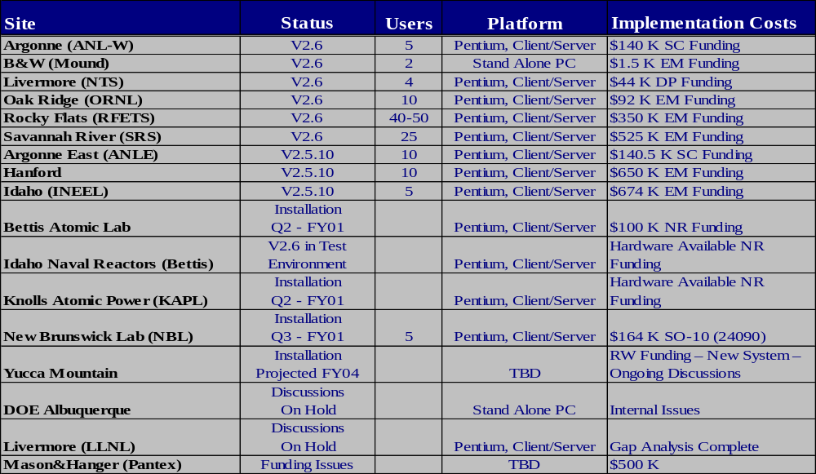
Status of Implementation and Migration Schedule and Locations
Project Schedule - DOE Site Implementation
SAMPLE
Notes:
SLIDE TITLE: Site Implementation Schedule
FREQUENCY: N/A – Sample slide.
PURPOSE: Provides an example of how information for the Status of Migration and Implementation Locations slide may be provided.
SOURCE(S): Project Plan, Quality Plan, and other project related documentation.
PROCESS: N/A - This slide is not to be included in the presentation and is provided as a sample only.

Slide 5
Project Deliverables
Software Lifecycle Stages and Deliverables
Reference Slide Only
Planning
Requirements Definition
Feasibility Statement
Project Plan
Software Quality Assurance Plan
Software Configuration Management Plan
Requirements Traceability Matrix (draft)
Continuity of Operations Statement/Plan
Data Dictionary (draft)
Software Requirements Specification
Project Test Plan
Acceptance Test Plan (draft)
Project Plan (revised)
Functional Design
System Design
Logical Model
Data Dictionary (revised)
Requirements Traceability Matrix (expanded)
Functional Design Document
Project Plan (revised)
Data Dictionary (expanded)
Physical Model
Integration Test Plan (draft)
System Test Plan (draft)
Requirements Traceability Matrix (expanded)
Conversion Plan
System Design Document
Program Specifications
Programming Standards
Project Plan (revised)
Notes:
SLIDE TITLE: Software Lifecycle Stages and Deliverables (reference slide)
FREQUENCY: Not applicable, example of deliverable types by stage.
PURPOSE: Provide reference material for the Project Deliverables slide.
SOURCE(S): DOE Systems Engineering Methodology (SEM) DOE G 200.1-1A.
PROCESS: This slide is a sample of project deliverables that may be included in the project deliverables slide. This slide is not to be included in the presentation and is provided for reference only.

Slide 6
Project Deliverables
Software Lifecycle Stages and Deliverables (Continued)
Reference Slide Only
Construction
Acquisition Plan
Installation Plan (draft)
Requirements Traceability Matrix (expanded)
Integration Test Plan (final)
System Test Plan (final)
Software Baseline
Transition Plan
Operating Documents (draft)
Training Plan (draft)
Project Plan (revised)
Software Integration & Testing
Integration Test Reports
System Test Report
Operating Documents (final)
Training Plan (final)
Installation Plan (final)
Acceptance Test Plan (final)
Preacceptance Checklist
Requirements Traceability Matrix (final)
Maintenance Plan (draft)
Project Plan (revised)
Installation and Acceptance
Installation Test Materials
User Training Materials
Acceptance Test Materials
Acceptance Test Report
Acceptance Checklist
Operational System
Operating Documents
Maintenance Plan (final)
Project Plan (final)
Software Maintenance
Revise all affected documentation
Retirement
Computer System Retirement Guidelines
Notes:
SLIDE TITLE: Software Lifecycle Stages and Deliverables (Reference Slide Continued)
FREQUENCY: Not applicable, example of deliverable types by stage.
PURPOSE: Provide reference material for the Project Deliverables slide.
SOURCE(S): DOE Systems Engineering Methodology (SEM) DOE G 200.1-1A.
PROCESS: This slide is a sample of project deliverables that may be included in the project deliverables slide. This slide is not to be included in the presentation and is provided for reference only.

Slide 7
Summary of Project Stages
Stages | Description
Planning | System requirements are identified, the users' environment is analyzed, the project objectives and scope are defined, the high-level project and functional requirements are estimated, the feasibility of the project is determined, and the Project Plan, Software Quality Assurance Plan and Software Configuration Management Plan are developed and approved.
Requirements Definition | Analysis of the system owner/users' business processes and needs, translation of those processes and needs into formal requirements, and planning the testing activities to validate the performance of the software product are conducted.
Functional Design | The overall structure of the software product is defined from a functional viewpoint to include the logical system flow, data organization, system inputs and outputs, processing rules, and operational characteristics of the software product from the user's point of view.
System Design | The user-oriented functional design specifications are translated into a set of technical, computer-oriented system design specifications.
Programming | The system design is transformed into the first complete representation of the software product.
Integration and Testing | Software components are integrated and tested to determine whether the software product meets predetermined functionality, performance, quality, interface, and security requirements.
Installation and Acceptance | The objectives of the activities in this stage are to verify that the software product meets design requirements and to obtain the system owner's acceptance and approval of the software product.
SAMPLE
Notes:
SLIDE TITLE: Summary of Project Stages
FREQUENCY: N/A – Sample slide use DOE SEM Lifecycle
PURPOSE: Provides an example of how information for the Summary of Project Stages or Phases may be provided.
SOURCE(S): Systems Engineering Methodology (SEM) DOE G 200.1-1A.
PROCESS: N/A - This slide is provided as a sample only.

Slide 8
Summary of Project Phases
Phase | Primary Purpose
Prepare | Assess critical processes, readiness for change, current IT infrastructure and application portfolio Specify high level requirements and future capabilities Identify gaps between the current and future systems
Focus | Focus on closing identified gaps Define future processes based on industry best practices Identify IT infrastructure & organizational design support
Select | Select or validate the package solution that best suits the business requirements Prepare a business case with costs and benefits
Re-Design /Design | Assist client in re-designing the processes and organization and in matching processes to package functionality Focus package training for clients so they can assist in the documentation of future system processes
Configure | Develop, integrate and test the final configuration Develop end-user training specifications Plan the production, cut-over and post-live support
Deploy | Prepare the package, IT infrastructure & organization for going live Educate and train users, setup and operate Help Desk and provide end-user support
SAMPLE
Notes:
SLIDE TITLE: Summary of Project Phases
FREQUENCY: N/A – Sample slide using vendor lifecycle.
PURPOSE: Provides an example of how information for the Summary of Project Stages or Phases may be provided.
SOURCE(S): BMIS-Phoenix Project.
PROCESS: N/A - This slide is provided as a sample only.

Slide 9
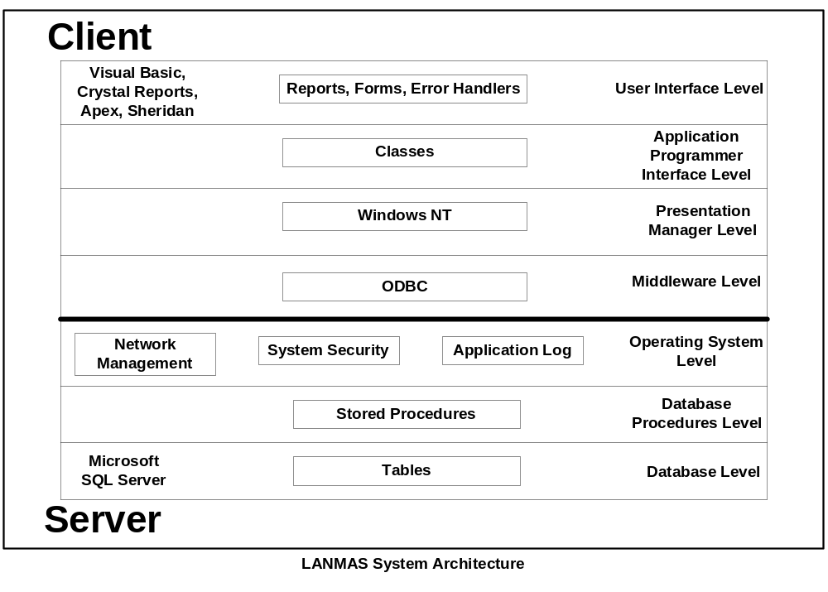
System Architecture
Physical View
SAMPLE
Notes:
SLIDE TITLE: System Architecture Physical View
FREQUENCY: N/A – Sample slide.
PURPOSE: Provides an example of how information for the Physical View of the Systems Architecture (hardware and software) may be provided (not all systems need to conform to this design). It is preferred that this information appear on one slide. This information will also be provided to the Departmental Information Architecture Program. Ensuring systems fit into an Enterprise Architecture is a mandate per OMB Circular A-130.
SOURCE(S): JAD results, Project Plan, System Design, Feasibility Study and other related project documents.
PROCESS: N/A - This slide is provided as a sample only.

Slide 10

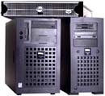
System Architecture
Physical View
Client Layer
Infrastructure Layer
Server Layer
Application Information
Protocol Information
Application Information
User information
DOE Headquarters
Security Information
Security Information
Middleware
DOE Sites
Data warehouse
SAMPLE
Notes:
SLIDE TITLE: System Architecture Physical View
FREQUENCY: N/A – Sample slide.
PURPOSE: Provides an example of how information for the Physical View of the Systems Architecture (hardware and software) may be provided (not all systems need to conform to this design). It is preferred that this information appear on one slide. This information will also be provided to the Departmental Information Architecture Program. Ensuring systems fit into an Enterprise Architecture is a mandate per OMB Circular A-130.
SOURCE(S): JAD results, Project Plan, System Design, Feasibility Study and other related project documents.
PROCESS: N/A - This slide is provided as a sample only.

